Slide 1
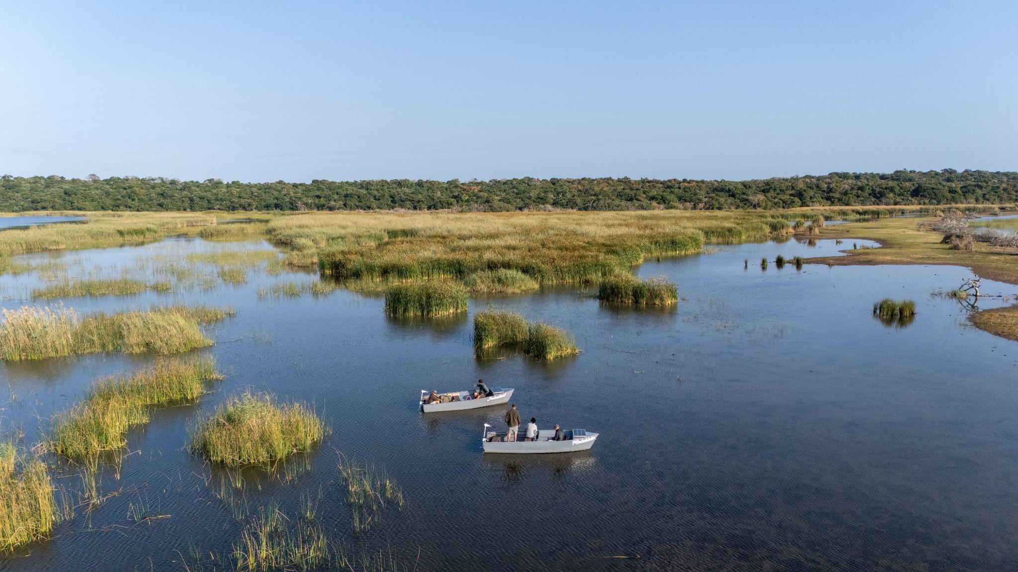


iSimangaliso Wetland Park World Heritage Site, KwaZulu Natal, South Africa
Rack Rates 2026 2027

Slide 2
Makakatana Bay Lodge
2026
Luxury Suites
Total 5 | 3 Twin (2 x Sgl beds), 2 Double (1 x King bed). 3rd person available on a single day bed.
Seasons | PPS (Per Person Sharing) | SGL (Single) pays + 50% | Third adult sharing pays 80% | Child 6 - 12 yrs - 50% if sharing with 2 adults
1 Jan - 31 December | R10 880 | R16 320 | R8 704 | R5 440
1 May - 30 June (Winter Rate) | R9 250 | R13 875 | R7 400 | R4 625
Honeymoon Suite
Total 1 | King bed and a day bed.
Seasons | PPS (Per Person Sharing) | SGL (Single) pays + 50% | Third adult sharing pays 80% | Child 6 - 12 yrs - 50% if sharing with 2 adults
1 Jan - 31 December | R11 680 | R17 520 | n/a | n/a
1 May - 30 June (Winter Rate) | R9 930 | R14 895 | n/a | n/a
Family Suites
Total 2 | Sleeps 4 with full king bed and 2 twin beds in separate interleading bedroom.
Seasons | 3 or less Occupants | 4 Occupants
1 Jan - 31 December | R32 645 | The Luxury Suite Rates apply as per above (2 x PPS) + (2 x Third adult sharing)
1 May - 30 June (Winter Rate) | R27 750
Includes:
Luxury Accommodation, all meals, scheduled activities, teas, coffees, soft drinks and local house wine and beers.
Excludes:
Conservation Levy, iSimangaliso Park Entry fees, other extra activities, premium brands & spirits, items of a personal nature and gratuities.
Note:
Please note that if you book a one night stay on a Fully Inclusive or Full Board basis, you will only have the option to book an afternoon drive on the day of arrival and a morning game drive on the morning of departure. Full day safaris cannot be booked as an extra activity on a one night stay.
5 Luxury Suites
Double or twin plus 3rd person available on a single day bed.
Seasons | PPS (Per Person Sharing) | SGL (Single) pays + 50% | Third adult sharing pays 80% | Child 6 - 12 yrs - 50% if sharing with 2 adults
1 Jan - 31 December | R8 705 | R13 058 | R6 964 | R4 353
1 May - 30 June (Winter Rate) | R7 400 | R11 100 | R5 920 | R3 700
1 Honeymoon Suite
Seasons | PPS (Per Person Sharing) | SGL (Single) pays + 50% | Third adult sharing pays 80% | Child 6 - 12 yrs - 50% if sharing with 2 adults
1 Jan - 31 December | R9 345 | R14 018 | n/a | n/a
1 May - 30 June (Winter Rate) | R7 945 | R11 918 | n/a | n/a
2 Family Suites
Sleeps 4. King bed with an interleading room with 2 x single beds.
Seasons | 3 or less Occupants | 4 Occupants
1 Jan - 31 December | R26 115 | The Luxury Suite Rates apply as per above when there are 4 people in the family room ie: (2 x PPS) + (2 x Third adult sharing)
1 May - 30 June (Winter Rate) | R22 200
Includes:
Luxury Accommodation, all meals, teas, coffees, and filtered water
Excludes:
All drinks, all activities, conservation Levy, iSimangaliso Park Entry fees,, items of a personal nature and gratuities. ** Any specials offered are subject to different inclusions and exclusions.
Note:
Please note that if you book a one night stay on a Fully Inclusive or Full Board basis, you will only have the option to book an afternoon drive on the day of arrival and a morning game drive on the morning of departure. Full day safaris cannot be booked as an extra activity on a one night stay.
NEW!
Rack- Fully Inclusive
Rack – Full Board

Slide 3





Makakatana Bay Lodge
2026
ACTIVITIES
Included in the Fully Inclusive Package. Alternatively, they can be booked as Extras for Full Board Guests - Minimum of 2 people. All prices per person. Times are subject to change.
(Non-commissionable) |  | Full Board | Fully Inclusive
Afternoon Wetland Drive (15h30 – 18h30) |  | R1 380 | Included
Boat Safari - Full day |  | R3 200 | Included
Beach Safari (transfer across the lake by boat – weather permitting) – or game drive to beach – confirmed by management on day of activity Full day |  | R3 200 | Included
Hluhluwe Game Reserve – (Full day – On request ) |  | R3 600 | Included
Morning Game Drive (05h00 – 08h00) |  | R1 380 | Included
Eco boat trips (An option to do the eco boat instead of the am or pm drives if available & weather permitting) |  | R1 380 | Included
NEW Trails on the Eastern Shores – transfer across the lake by boat (weather permitting or drive around)– prices on request All activities are weather permitting. In high winds or dangerous weather conditions, alternative activities will be offered where we are able to. Note - Full day activities cannot be booked on a 1 night stay.
Extra External Activities
Birding, whale watching, horse riding and deep-sea fishing can be booked as extras directly with the external operators. They do not include transfers from the lodge. Prices available on request.
One Way Transfer Rates to/from St Lucia | During park hours |  | R1 380
 | After park hours |  | R3 061
 | iBrochure
 | Online Booking
 | book@makakatana.com
 | Res 1: +27 (0) 87 059 9015 Lodge +27 (0) 79 053 3821
 | www.makakatana.com
Guide Room Rates:
Guides/ Drivers are encouraged to stay in St Lucia as they might be charged single nett rate of a single luxury suite.
Minimum Stay Requirement:
Minimum stay of 2 nights between 15 December and 10 January and Easter Weekend.
Lodge Information
Activities
Conservation Levies
Supporting: African Wildlife Vets I Ezemvelo Anti Poaching Unit | Honorary Rangers I Simangaliso Conservation Projects | Other community projects
Per Adult/Per Night |  |  | Per Child/Per Night
R130(TBC) |  |  | R65(TBC)
iSimangaliso Park Entry Fees
Subject to change without notice - Payable in cash on arrival at the Gate
Entry Fee: per adult per stay | Entry Fee: per child per stay | Community per person |  | Overnight Levy per person per night | Vehicle entry (1-5 People)
R143 | R98 | R10 |  | R15 | R76
Guests arriving after gate hours will require a lodge staff member to meet them at the Nhlozi Gate to escort them to the lodge. Late entrance after 9pm attracts a R 375 per person late entrance fee. Late entrance and exit only permitted through Nhlozi gate. Entry permits to be handed back to the gate on exiting the park or a R 600 penalty is charged by the Park Authority. Speed limit is 40km/hour. No trailers or motorbikes.
Child Policy:
Children 6-12 years of age welcomed.
Children under the age of 12 are to be under supervision of their parents at all times.
See Full Child Policy which it to be signed by the parents prior to arrival.

Slide 4
Makakatana Bay Lodge
2027
Luxury Suites
Total 5 | 3 Twin (2 x Sgl beds), 2 Double (1 x King bed). 3rd person available on a single day bed.
Seasons | PPS (Per Person Sharing) | SGL (Single) pays + 50% | Third adult sharing pays 80% | Child 6 - 12 yrs - 50% if sharing with 2 adults
1 Jan - 31 December | R10 880 | R16 320 | R8 704 | R5 440
1 May - 30 June (Winter Rate) | R9 250 | R13 875 | R7 400 | R4 625
Honeymoon Suite
Total 1 | King bed and a day bed.
Seasons | PPS (Per Person Sharing) | SGL (Single) pays + 50% | Third adult sharing pays 80% | Child 6 - 12 yrs - 50% if sharing with 2 adults
1 Jan - 31 December | R11 680 | R17 520 | n/a | n/a
1 May - 30 June (Winter Rate) | R9 930 | R14 895 | n/a | n/a
Family Suites
Total 2 | Sleeps 4 with full king bed and 2 twin beds in separate interleading bedroom.
Seasons | 3 or less Occupants | 4 Occupants
1 Jan - 31 December | R32 645 | The Luxury Suite Rates apply as per above (2 x PPS) + (2 x Third adult sharing)
1 May - 30 June (Winter Rate) | R27 750
Includes:
Luxury Accommodation, all meals, scheduled activities, teas, coffees, soft drinks and local house wine and beers.
Excludes:
Conservation Levy, iSimangaliso Park Entry fees, other extra activities, premium brands & spirits, items of a personal nature and gratuities.
Note:
Please note that if you book a one night stay on a Fully Inclusive or Full Board basis, you will only have the option to book an afternoon drive on the day of arrival and a morning game drive on the morning of departure. Full day safaris cannot be booked as an extra activity on a one night stay.
5 Luxury Suites
Double or twin plus 3rd person available on a single day bed.
Seasons | PPS (Per Person Sharing) | SGL (Single) pays + 50% | Third adult sharing pays 80% | Child 6 - 12 yrs - 50% if sharing with 2 adults
1 Jan - 31 December | R8 705 | R13 058 | R6964 | R4 353
1 May - 30 June (Winter Rate) | R7 400 | R11 100 | R5 920 | R3 700
1 Honeymoon Suite
Seasons | PPS (Per Person Sharing) | SGL (Single) pays + 50% | Third adult sharing pays 80% | Child 6 - 12 yrs - 50% if sharing with 2 adults
1 Jan - 31 December | R9 345 | R14 018 | n/a | n/a
1 May - 30 June (Winter Rate) | R7 945 | R11 918 | n/a | n/a
2 Family Suites
Sleeps 4. King bed with an interleading room with 2 x single beds.
Seasons | 3 or less Occupants | 4 Occupants
1 Jan - 31 December | R26 115 | The Luxury Suite Rates apply as per above when there are 4 people in the family room ie: (2 x PPS) + (2 x Third adult sharing)
1 May - 30 June (Winter Rate) | R22 200
Includes:
Luxury Accommodation, all meals, teas, coffees, and filtered water
Excludes:
All drinks, all activities, conservation Levy, iSimangaliso Park Entry fees,, items of a personal nature and gratuities. ** Any specials offered are subject to different inclusions and exclusions.
Note:
Please note that if you book a one night stay on a Fully Inclusive or Full Board basis, you will only have the option to book an afternoon drive on the day of arrival and a morning game drive on the morning of departure. Full day safaris cannot be booked as an extra activity on a one night stay.
Rack – Fully Inclusive
Rack – Full Board

Slide 5
Makakatana Bay Lodge
2027
ACTIVITIES
Included in the Fully Inclusive Package. Alternatively, they can be booked as Extras for Full Board Guests - Minimum of 2 people. All prices per person. Times are subject to change.
(Non-commissionable) |  | Full Board | Fully Inclusive
Afternoon Wetland Drive (15h30 – 18h30) |  | R1 380 | Included
Boat Safari - Full day |  | R3 200 | Included
Beach Safari (transfer across the lake by boat – weather permitting) – or game drive to beach – confirmed by management on day of activity Full day |  | R3 200 | Included
Hluhluwe Game Reserve – (Full day – On request ) |  | R3 600 | Included
Morning Game Drive (05h00 – 08h00) |  | R1 380 | Included
Eco boat trips (An option to do the eco boat instead of the am or pm drives if available & weather permitting) |  | R1 380 | Included
NEW Trails on the Eastern Shores – transfer across the lake by boat (weather permitting or drive around)– prices on request All activities are weather permitting. In high winds or dangerous weather conditions, alternative activities will be offered where we are able to. Note - Full day activities cannot be booked on a 1 night stay.
Extra External Activities
Birding, whale watching, horse riding and deep-sea fishing can be booked as extras directly with the external operators. They do not include transfers from the lodge. Prices available on request.
One Way Transfer Rates to/from St Lucia | During park hours |  | R1 380
 | After park hours |  | R3 061
 | iBrochure
 | Online Booking
 | book@makakatana.com
 | Res 1: +27 (0) 87 059 9015 Lodge +27 (0) 79 053 3821
 | www.makakatana.com
Guide Room Rates:
Guides/ Drivers are encouraged to stay in St Lucia as they might be charged single nett rate of a single luxury suite.
Minimum Stay Requirement:
Minimum stay of 2 nights between 15 December and 10 January and Easter Weekend.
Lodge Information
Activities
Conservation Levies
Supporting: African Wildlife Vets I Ezemvelo Anti Poaching Unit | Honorary Rangers I Simangaliso Conservation Projects | Other community projects
Per Adult/Per Night |  |  | Per Child/Per Night
R120(TBC) |  |  | R60(TBC)
iSimangaliso Park Entry Fees
Subject to change without notice - Payable in cash on arrival at the Gate
Entry Fee: per adult per stay | Entry Fee: per child per stay | Community per person |  | Overnight Levy per person per night | Vehicle entry (1-5 People)
TBC | TBC | TBC |  | TBC | TBC
Guests arriving after gate hours will require a lodge staff member to meet them at the Nhlozi Gate to escort them to the lodge. Late entrance after 9pm attracts a R 550 per person late entrance fee. Late entrance and exit only permitted through Nhlozi gate. Entry permits to be handed back to the gate on exiting the park or a R 600 penalty is charged by the Park Authority. Speed limit is 40km/hour. No trailers or motorbikes.
Child Policy:
Children 6-12 years of age welcomed.
Children under the age of 12 are to be under supervision of their parents at all times.
See Full Child Policy which it to be signed by the parents prior to arrival.

